Slide 1
PRS Requirements (beyond CRUD) Flow
Sean Blessing
June 2019

Slide 2
Components Break-Down by Folder
The components are all stored inside the folder : src\app\feature, with a subfolder for each entity. Suggested component break-downs, by feature are as follows. These are Sean’s but yours could be different, if you see the project differently. The primary CRUD components (-list, -create, -edit, -detail should be standard though):
user | vendor | product | pr | prli
user-list | vendor-list | product-list | purchase-request-list | purchase-request-line-item-create
user-create | vendor-create | product-create | purchase-request-create | purchase-request-line-item-edit
user-edit | vendor-edit | product-edit | purchase-request-edit
user-detail | vendor-detail | product-detail | purchase-request-detail
user-login |  |  | purchase-request-approve
 |  |  | purchase-request-lines
 |  |  | purchase-request-review

Slide 3
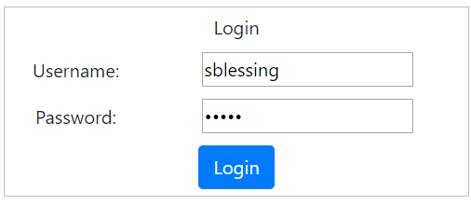
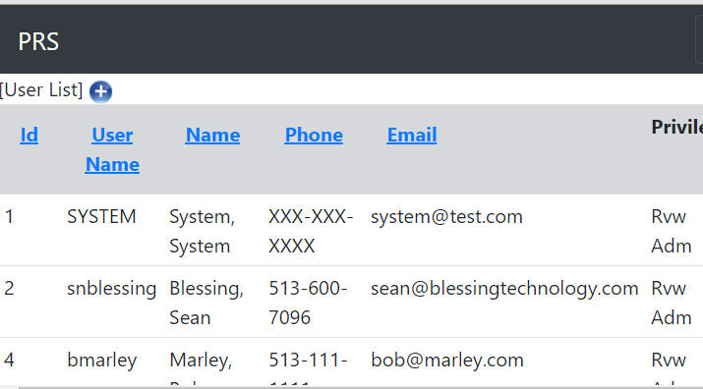
User Login
Login page is displayed: ‘user-login’ component
Successful login should result in display of ‘home’ page.
User-List is acceptable, but could also be the about or some other welcome page.

Slide 4
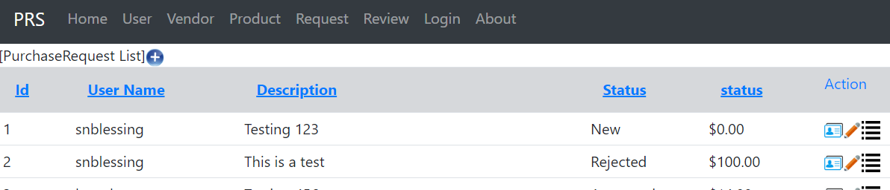
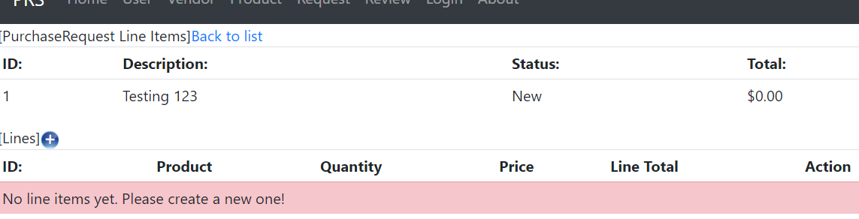
Adding Line Items
Clicking ‘Request’ should display all PRs [‘purchase-request-list’ component]
A 3rd ‘action’ icon, ‘lines’, is available on this screen
Clicking ‘lines’ will take you to the ‘Add Line Items’ page
[‘purchase-request-lines’ component]
Lines page will show PR summary at top, detail at bottom
Initially there should be a msg stating ‘no lines yet…’
Once lines are added they will appear and msg will disappear

Slide 5
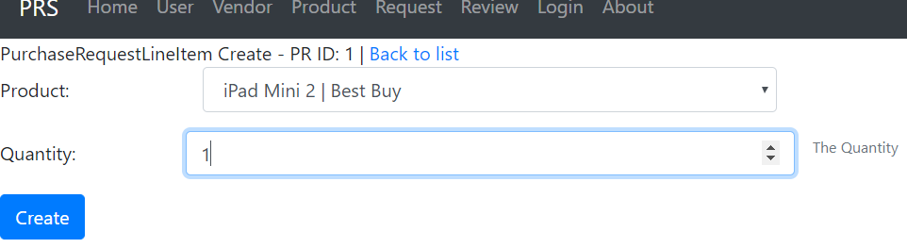
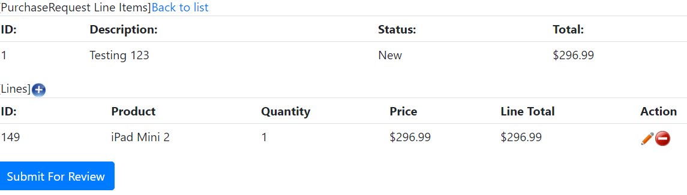
Adding Line Items (cont)
Clicking + icon will bring up line item add page
‘purchase-request-line-item-create’ component
User selects a product and quantity then clicks ‘create’

Slide 6
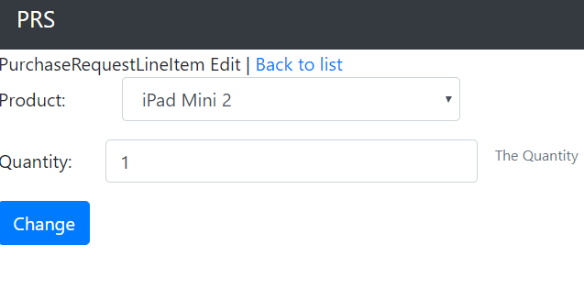
Editing / Deleting a PRLI
PRLIs can be edited or deleted
User clicks edit (pencil icon) and is taken to the edit PRLI page
[‘purchase-request-line-item-edit’ component]
User Clicks delete (minus icon) and the server deletes the record then this page is redisplayed

Slide 7
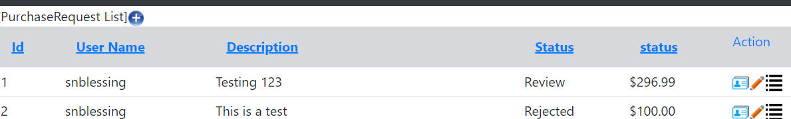
Submit Request for Review
Once a user has finished adding line items they are ready to submit their request for review.
User Clicks ‘submit for review’
This takes them back to the PR List page

Slide 8
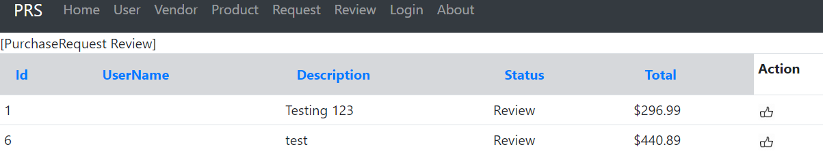
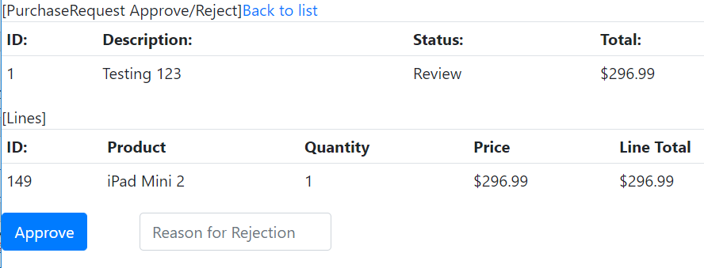
Request Review
The request review page is reached by clicking the ‘review’ menu item
[‘purchase-request-review’ component]
This is the list of PRs in ‘review’ status but NOT assigned to logged in user
User clicks the ‘thumbs’ action icon to select a request to approve/reject
‘purchase-request-approve’ component is displayed
User either approves or rejects request and is returned to PR Review page

